Slide 1

The Microbiome: Methods, Tools, and Examples
W. Evan Johnson, PhD
Professor of Medicine, Division of Infectious Disease
Director, Center for Data Science
Rutgers University – New Jersey Medical School

Slide 2

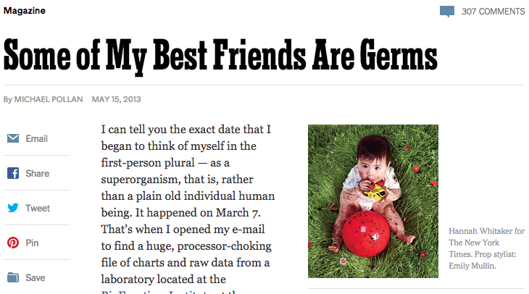




Slide 3
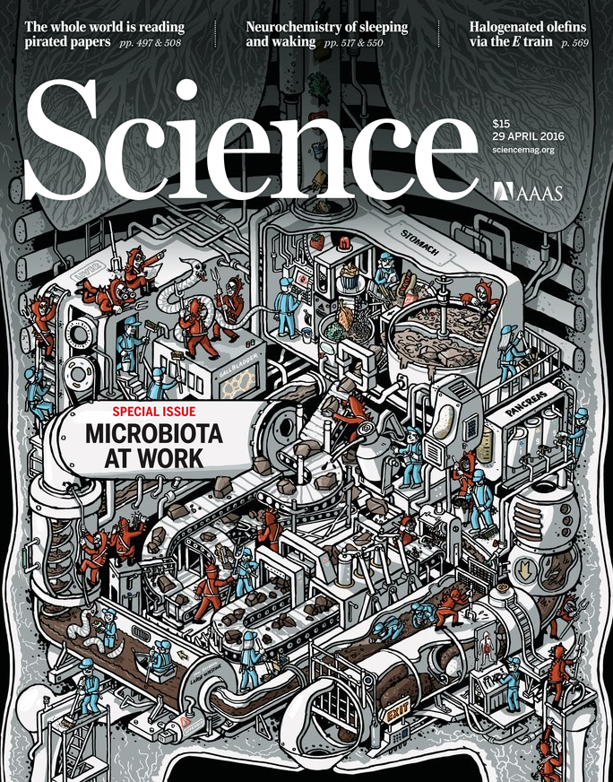

Notes:
The microbiome is popular; both Science and Nature have had special issues all about it.

Slide 4
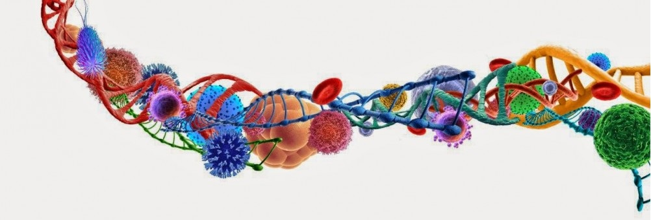

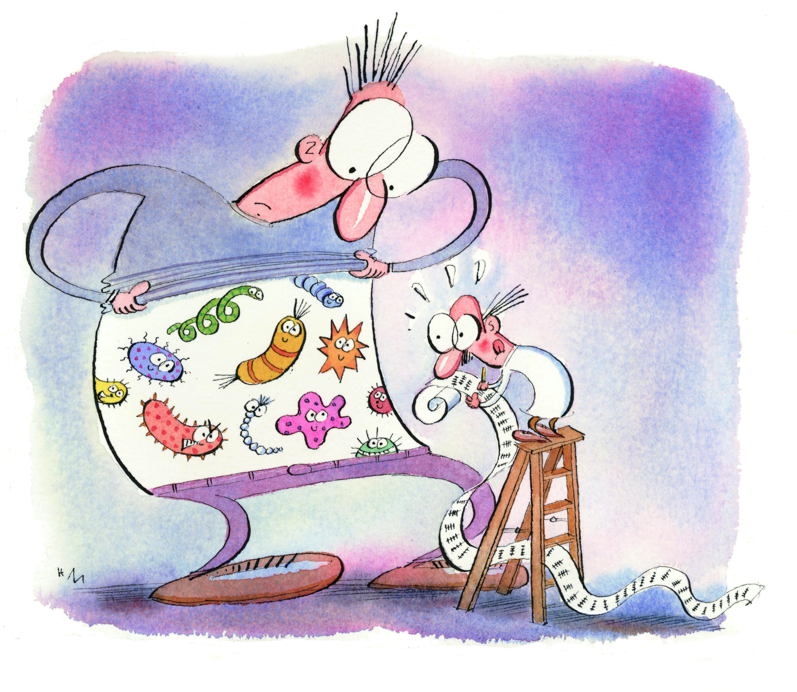

Our human cells are outnumbered!

Slide 5
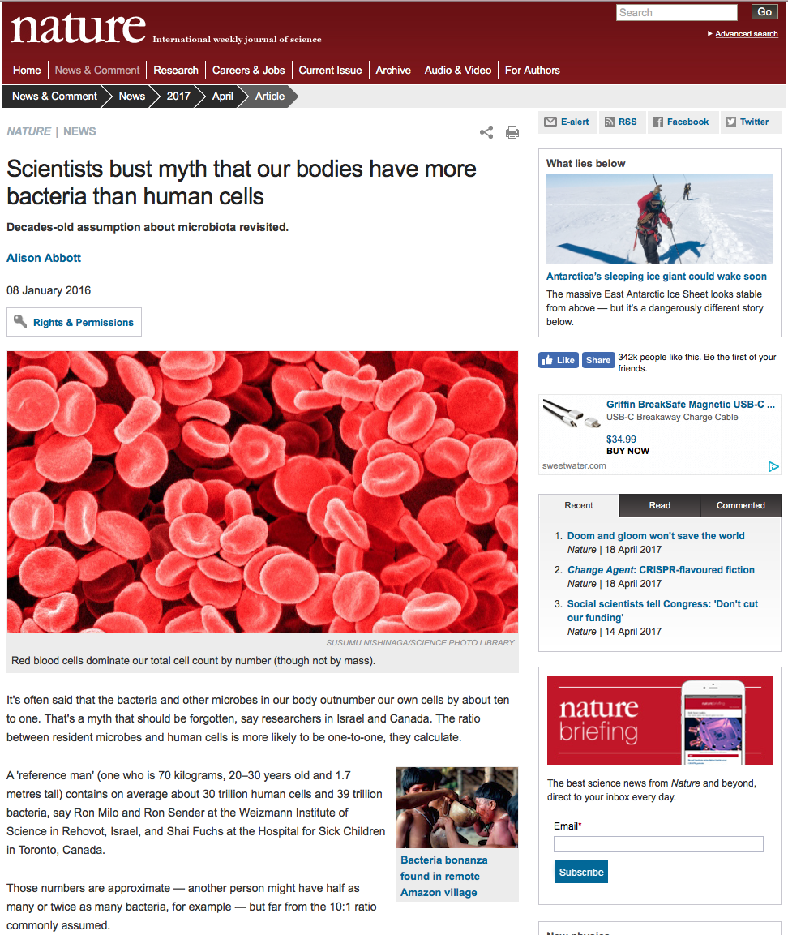

Slide 7
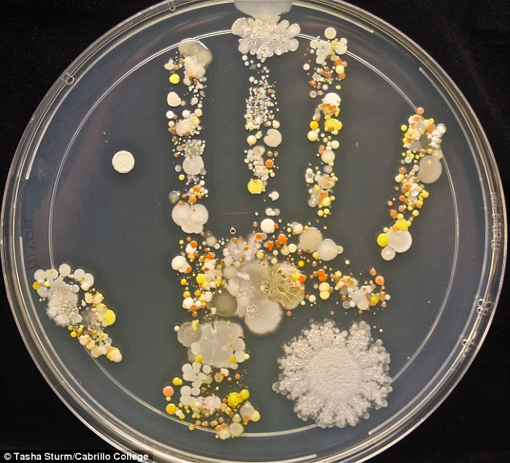

Slide 8
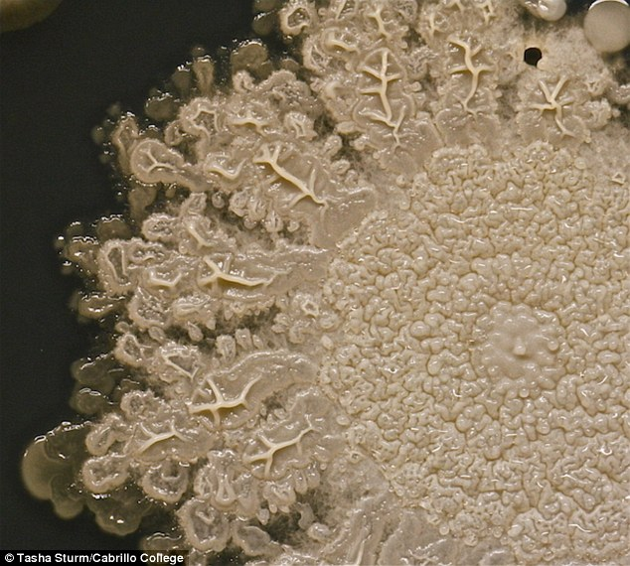
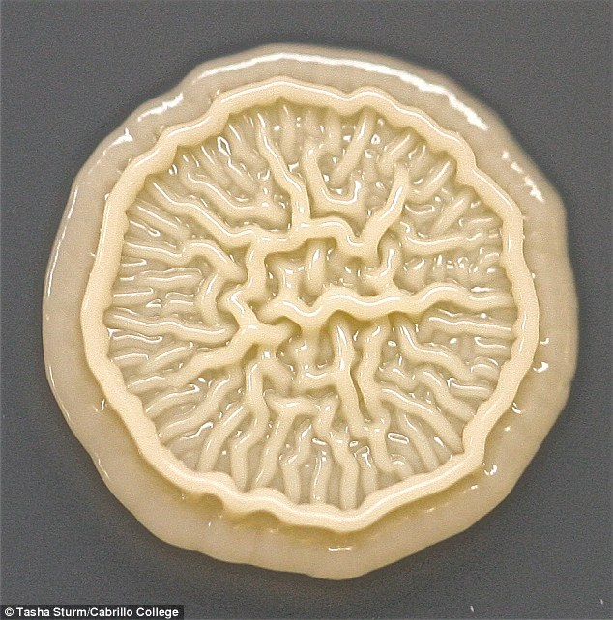
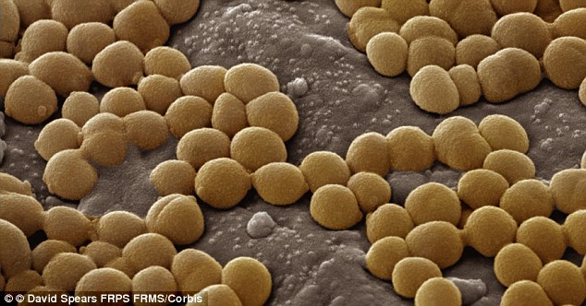

Slide 9
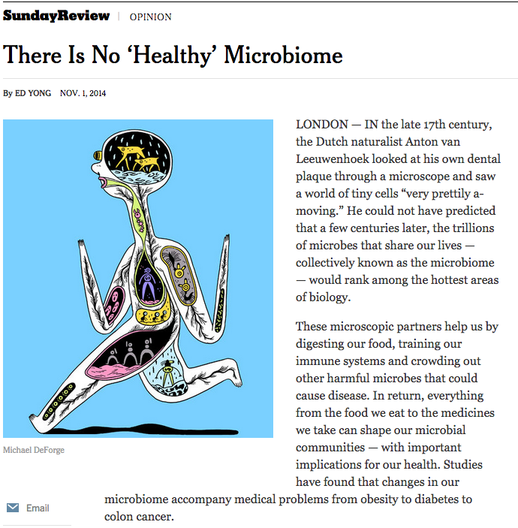

Slide 10
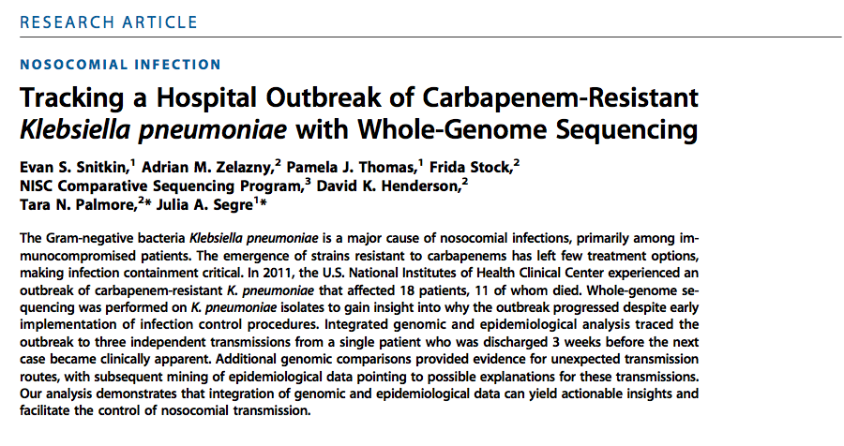

Slide 11


Slide 12
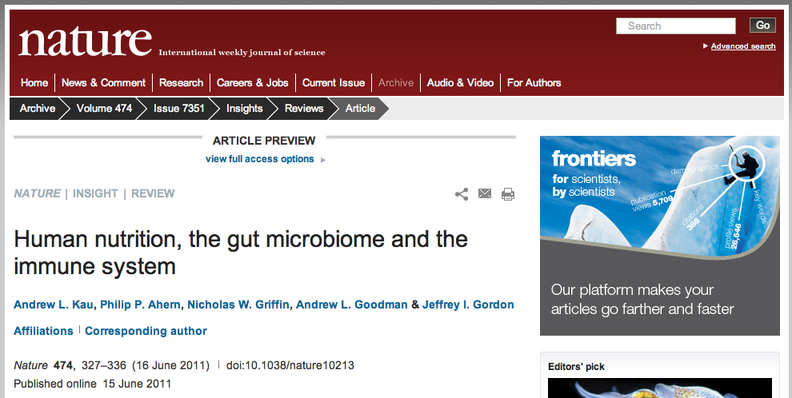

Slide 13


Slide 14
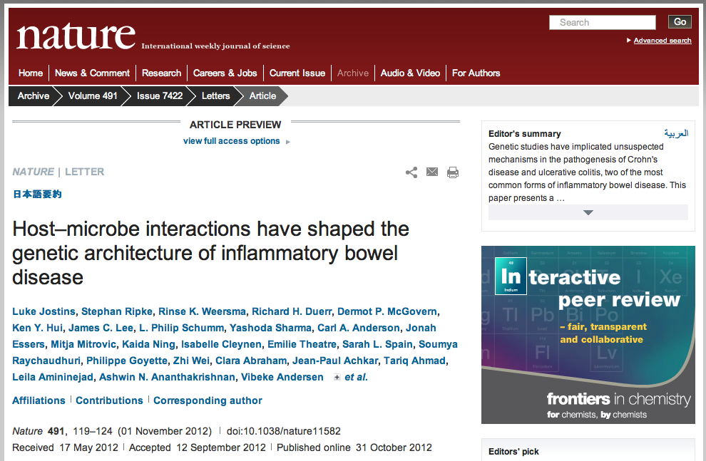

Slide 15
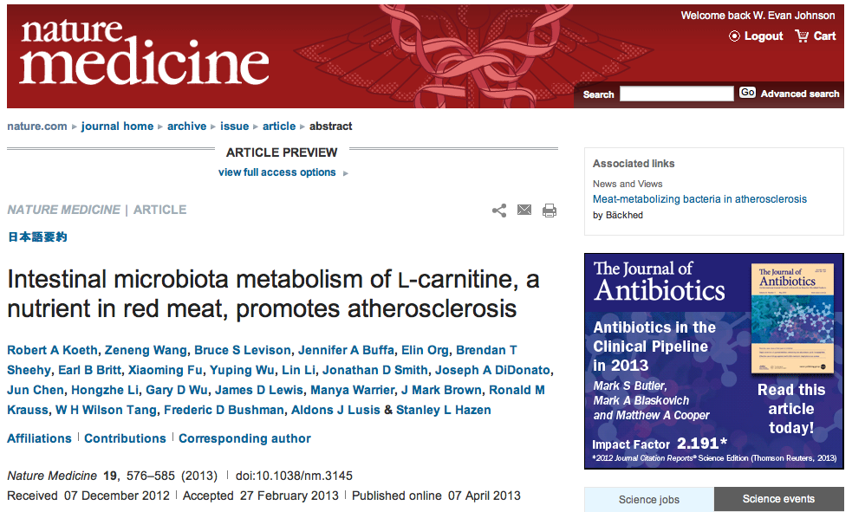

Slide 16
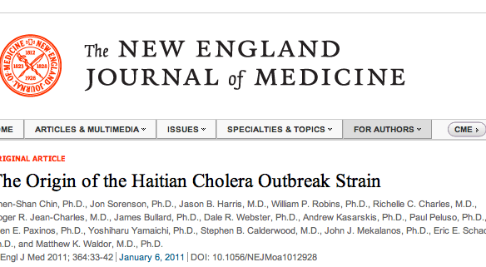

Slide 17
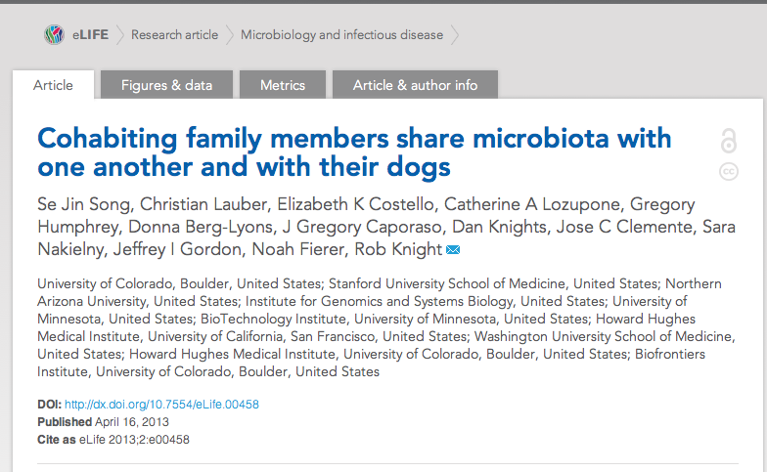

Slide 18

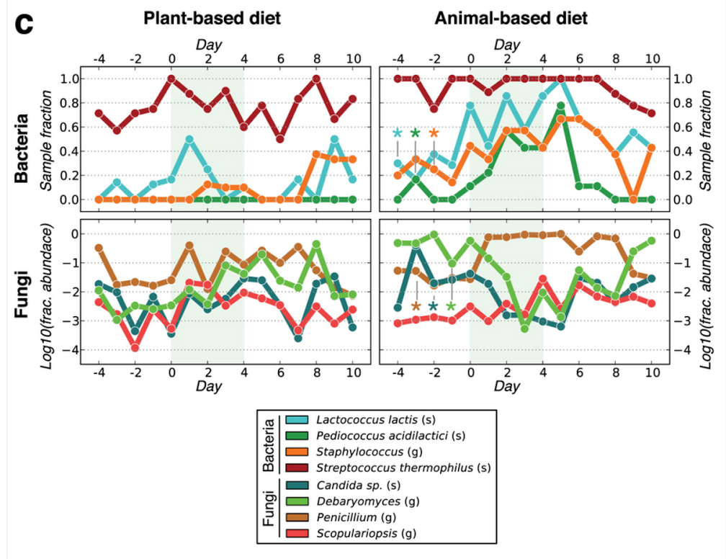

Slide 19
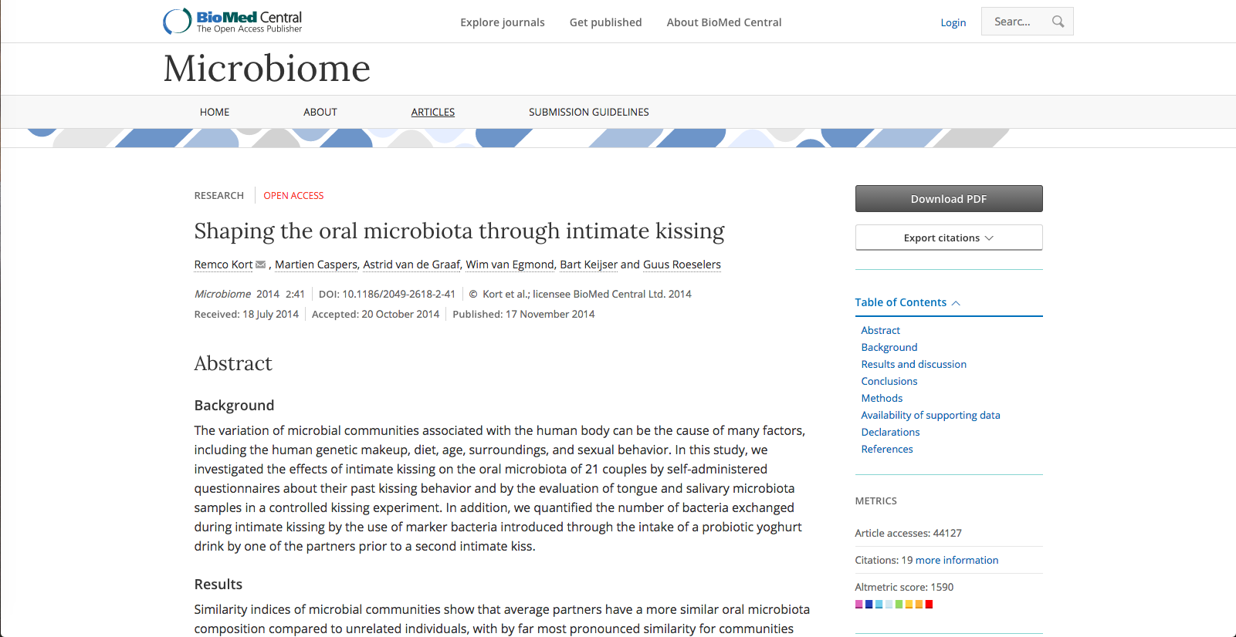

Slide 20
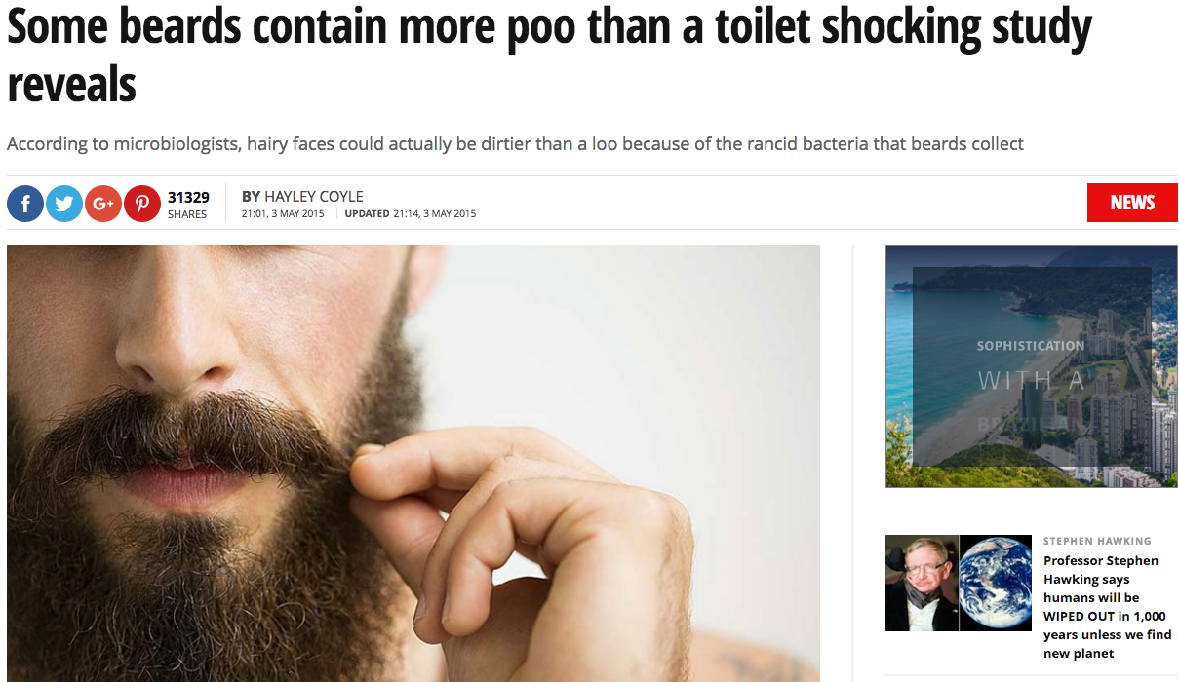

Slide 21
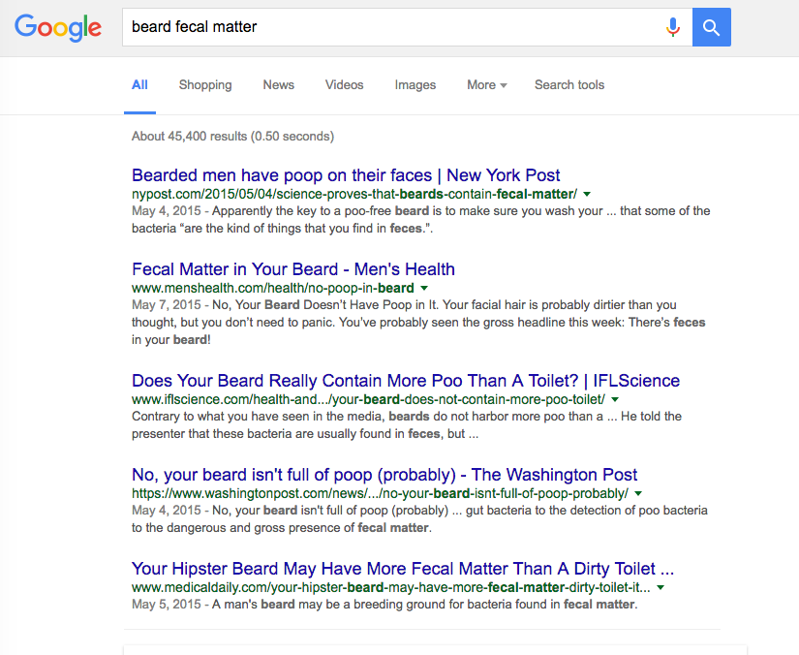

Slide 22
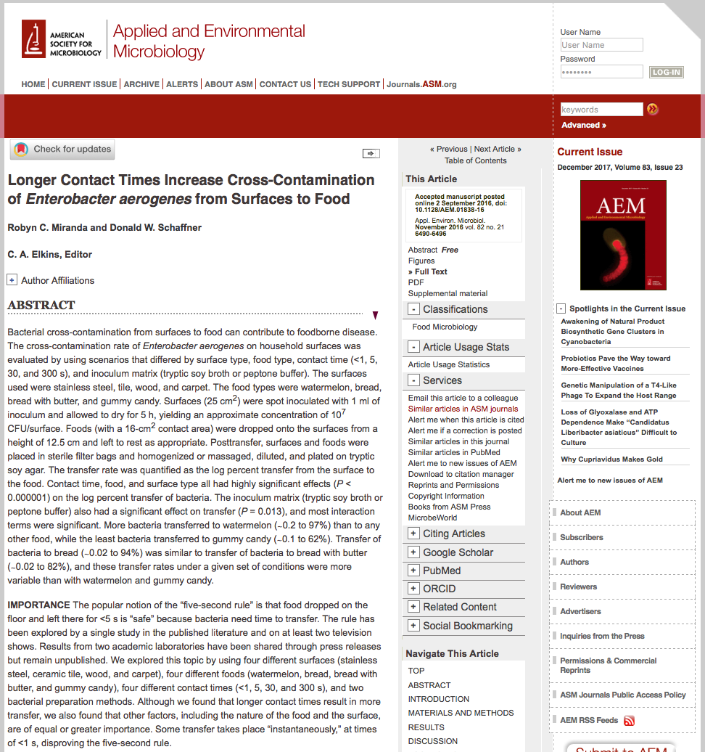

Slide 23
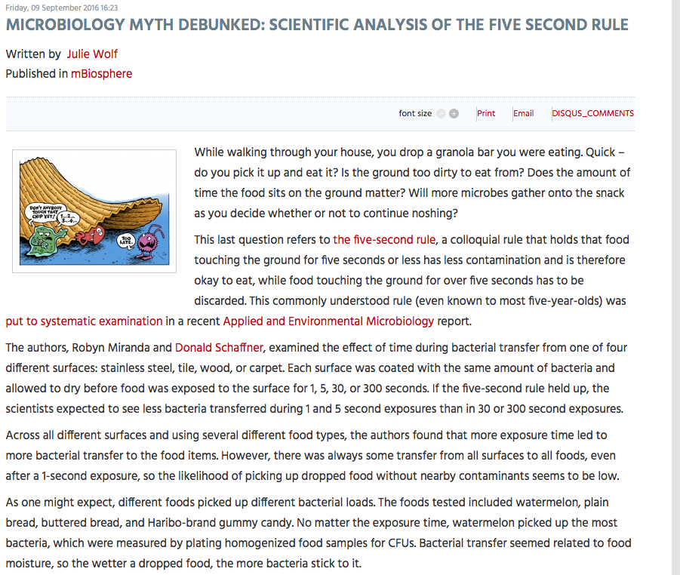

Slide 24
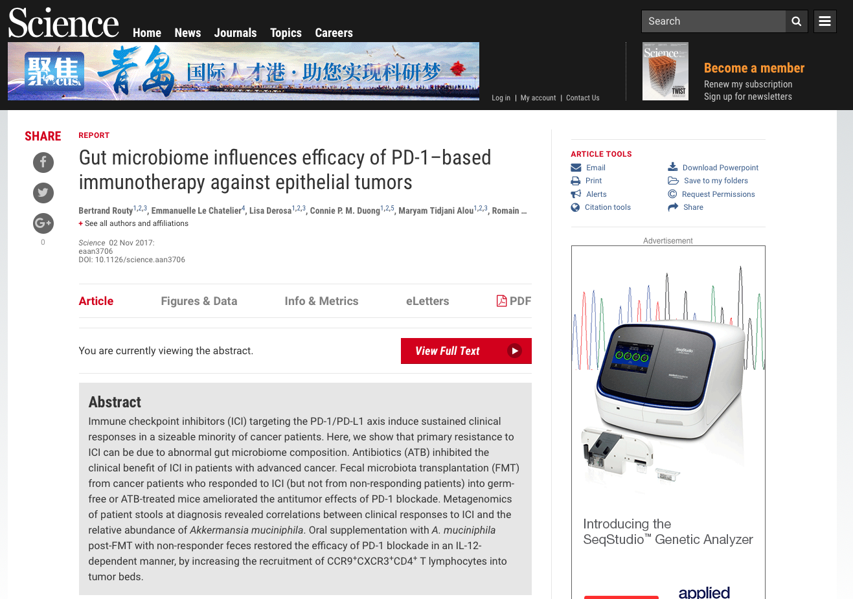
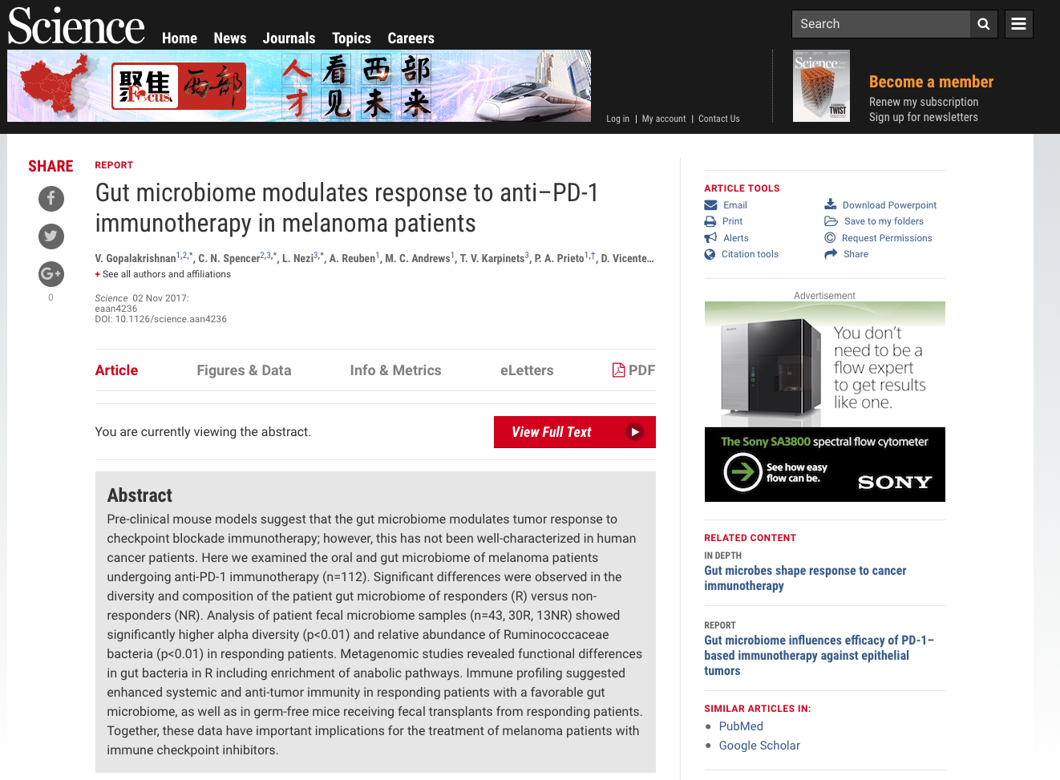
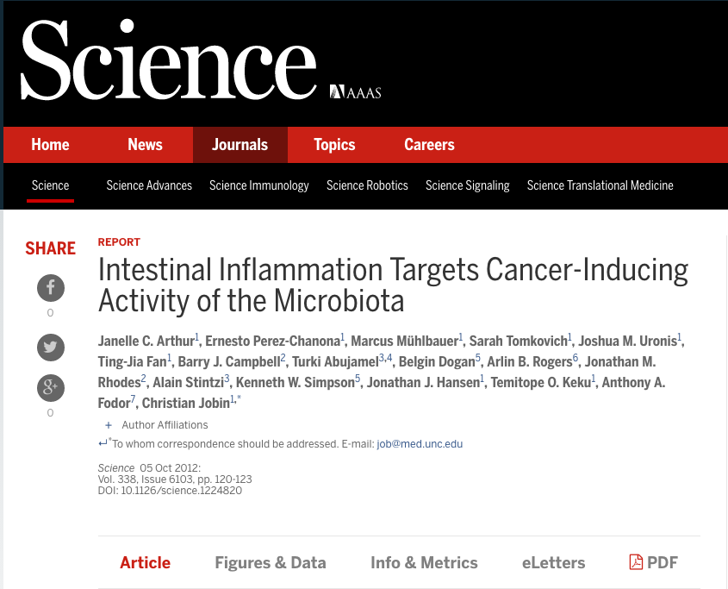

Slide 25
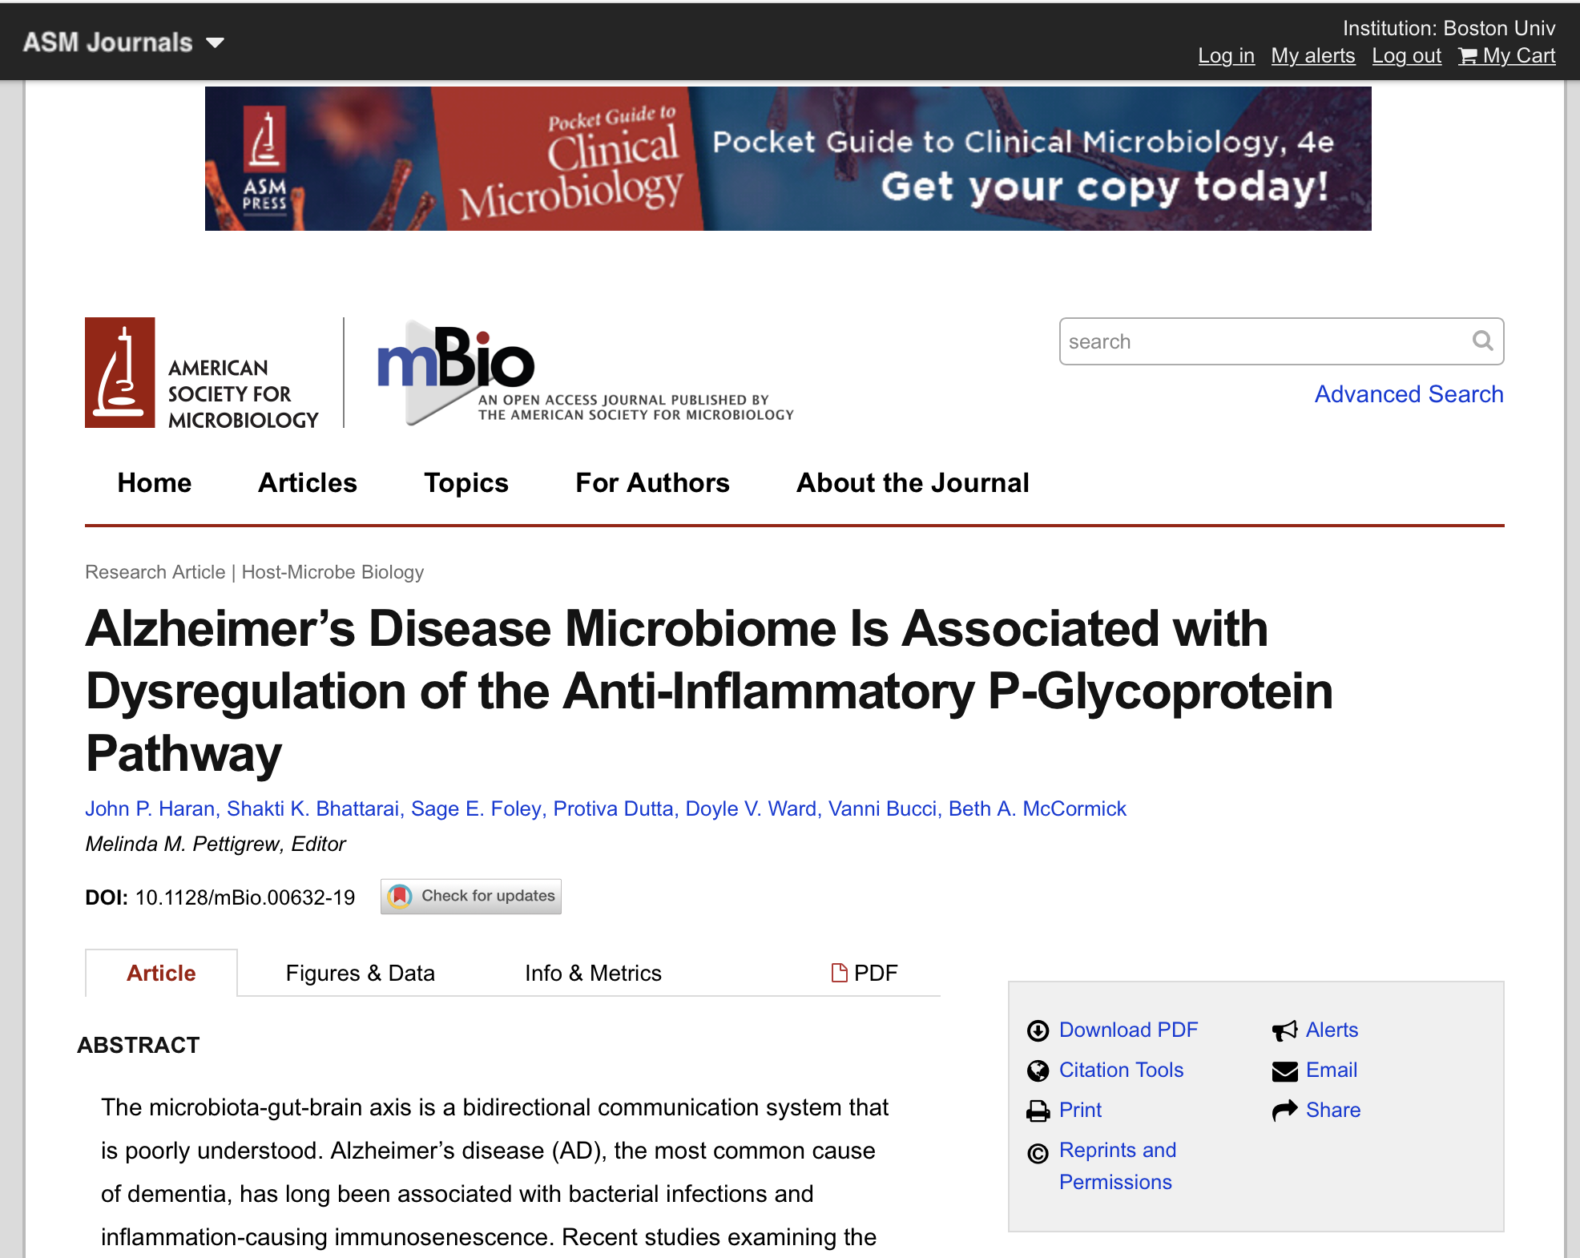
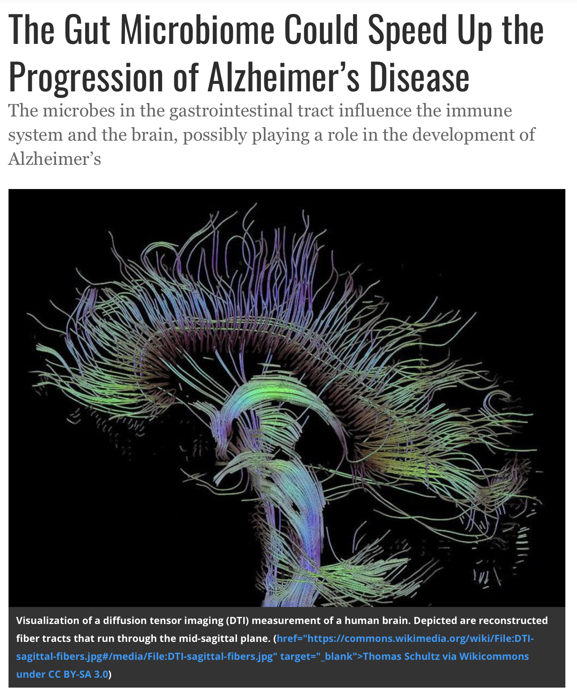

Slide 26
We depend on microbes and their metabolism
Garrett. JCB, 2015

Slide 27
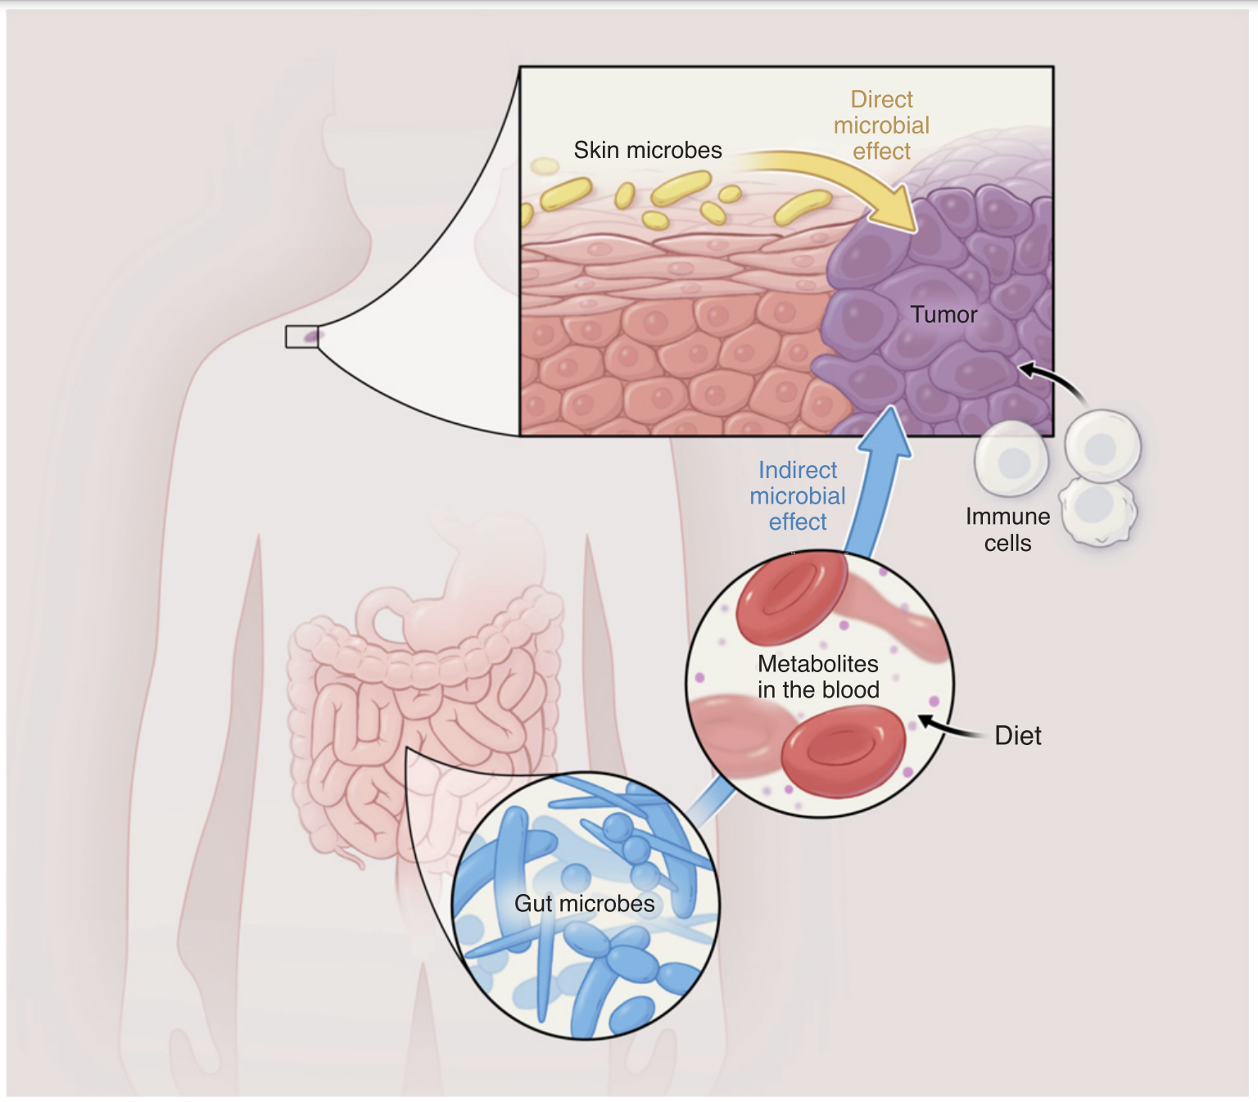
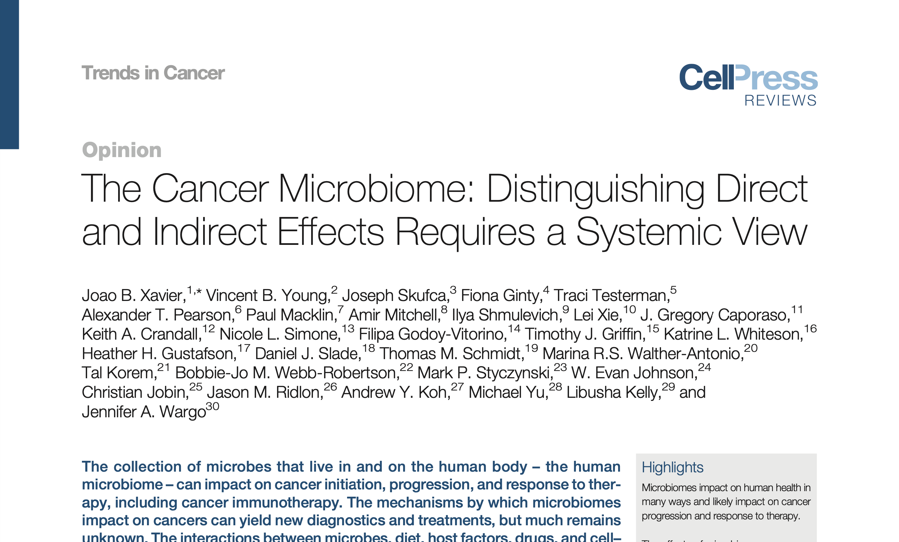
27

Slide 28
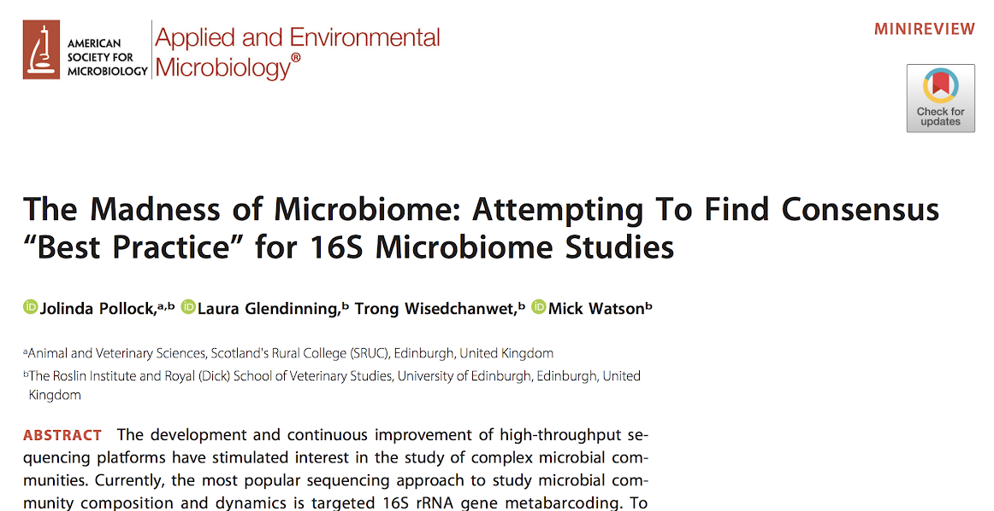

Current state of the microbiome

Slide 29

“Metagenomics” Etymology
Coined in 1998, collection of genetic material from multiple organisms, analyzed as if one genome
In Greek, meta means “transcendent”
2005: “the application of modern genomics techniques without the need for isolation and lab cultivation of individual species”

Slide 30
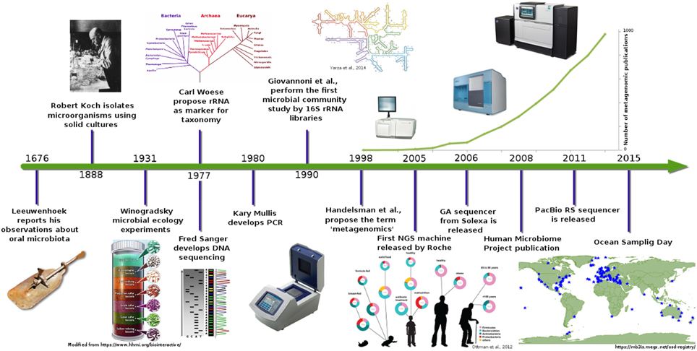
The History of the Microbiome

Slide 31
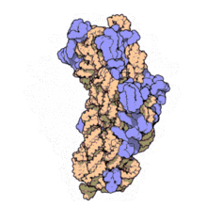
16S Ribosomal Sequencing
PCR amplify and sequence ~1.5kbp
Advantages
Conserved in bacteria (all have one)
Highly variable regions: identify taxonomy and phylogeny
Established and affordable
Disadvantages
Neglects viruses, fungi, parasites, etc
No strains or sometimes species identification
PCR bias?
The 16S subunit

Slide 32
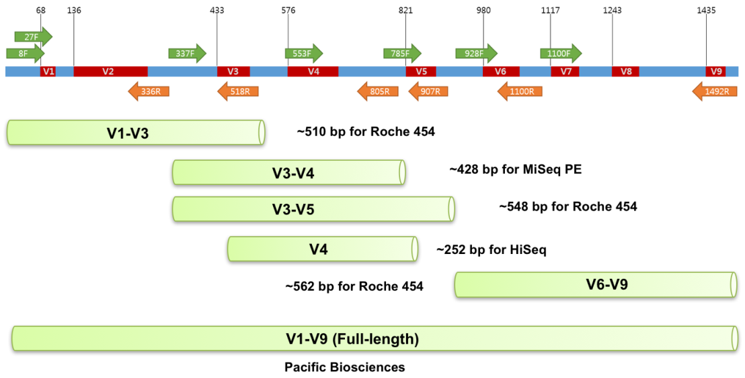
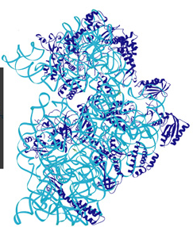
16S Ribosomal Sequencing
Amplicon Sequencing:16S rRNA

Slide 33
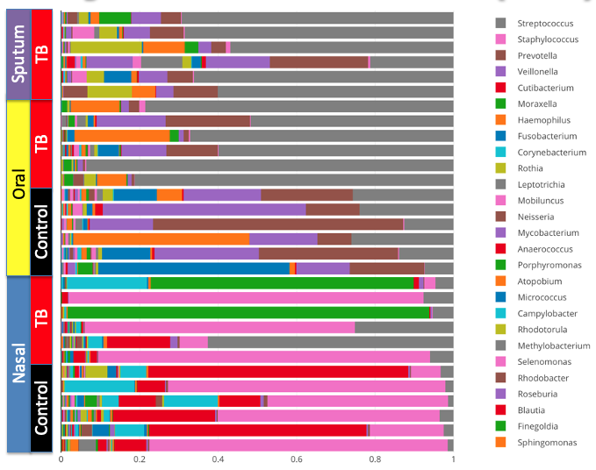
Airway Microbiome of TB (16S)

Slide 34


16S Genomic Diversity
16S gene
Different species have different copy numbers of 16S rDNA
16S gene

Slide 35
16S Genomic Diversity
…and each copy has a unique sequence!

Slide 36
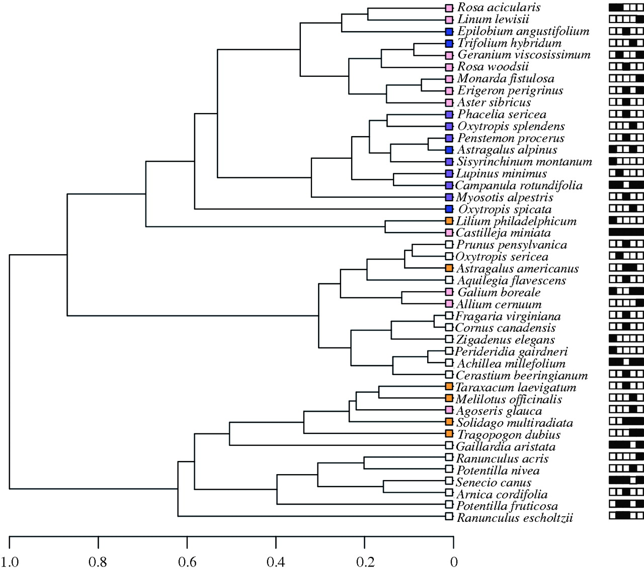
Ambiguous Alignments
When do ambiguous alignments appear?
Species 1
C
A
T
T
T
A
G
G
T
C
C
A
G
Species 2
C
A
T
T
T
A
G
A
G
T
C
C
A
G
Species 3
C
A
T
T
T
A
G
T
G
T
C
C
A
G
Low-diversity clade

Slide 37
Whole Metagenome Sequencing
Sequence whole (fragmented) DNA
Advantages:
Not limited to bacteria (viruses, fungi, parasites)
No PCR amplification bias
Disadvantages:
Host contamination in reads
Analysis:
Align to whole genome library
Need to filter host reads

Slide 38
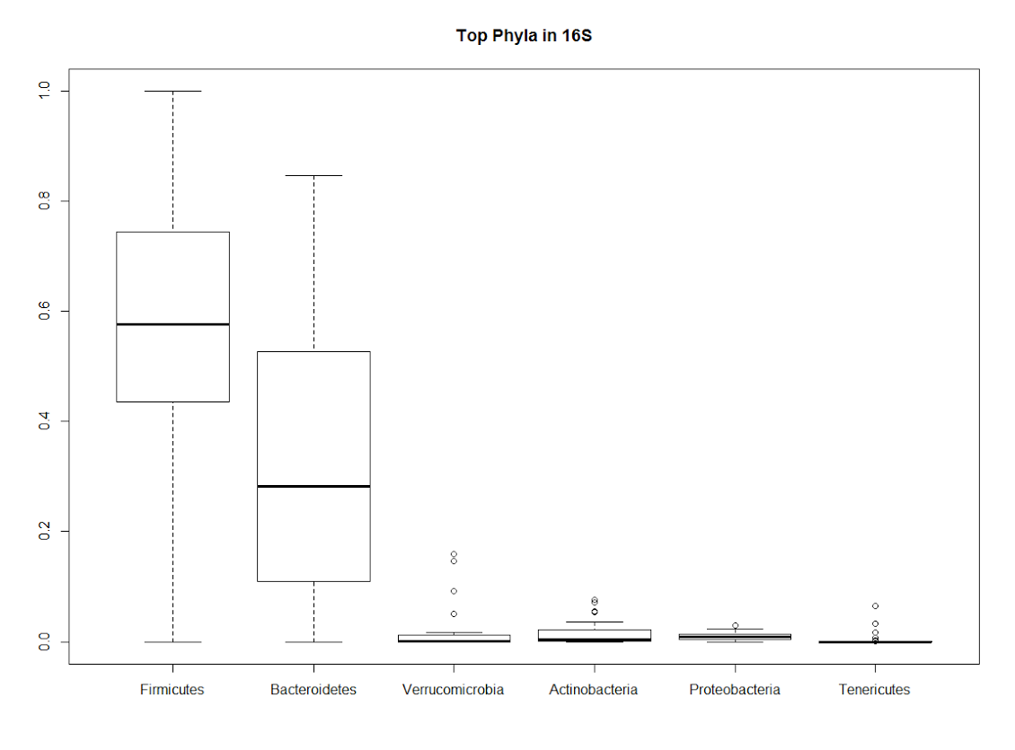
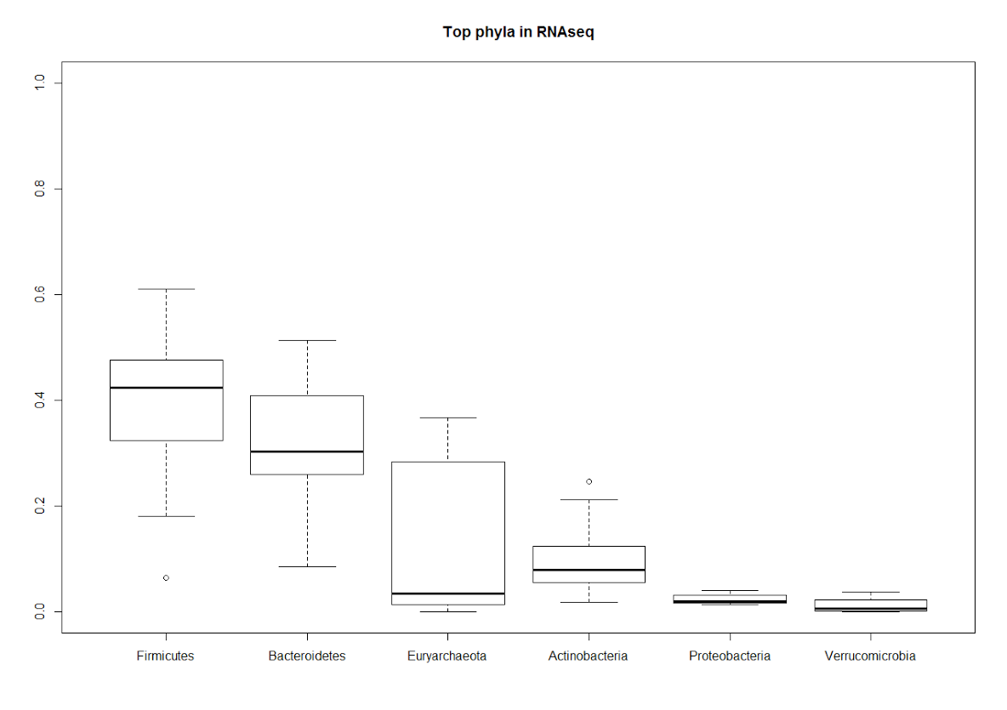
Metatranscriptome Sequencing
Sequence total RNA (deplete ribosomal RNA)
Get host transcription AND microbiome profile
Measures activity NOT abundance
Top Phyla in 16S rDNA-seq
Top Phyla in whole RNA-seq
Fermicutes Verrucomicrobia Proteobacteria
Bacteroidetes Actinobacteria Tenericutes
Fermicutes Euryarchaeota Proteobacteria
Bacteroidetes Actinobacteria Verrucomicrobia

Slide 39







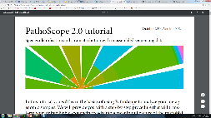


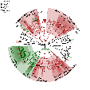



Experimental and Analysis Pipelines
Metagenomics Study
Whole Genome
Amplicon
OTU/Clustering
Full Reference
Biomarkers
PathoScope
Reference alignment
PathoScope
Reference-based
De novo
Amplicon DB
Whole genome
Assembly
Piecemeal
MEGAHIT

Slide 40
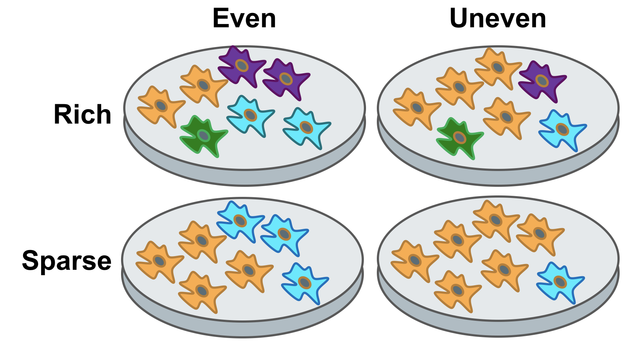
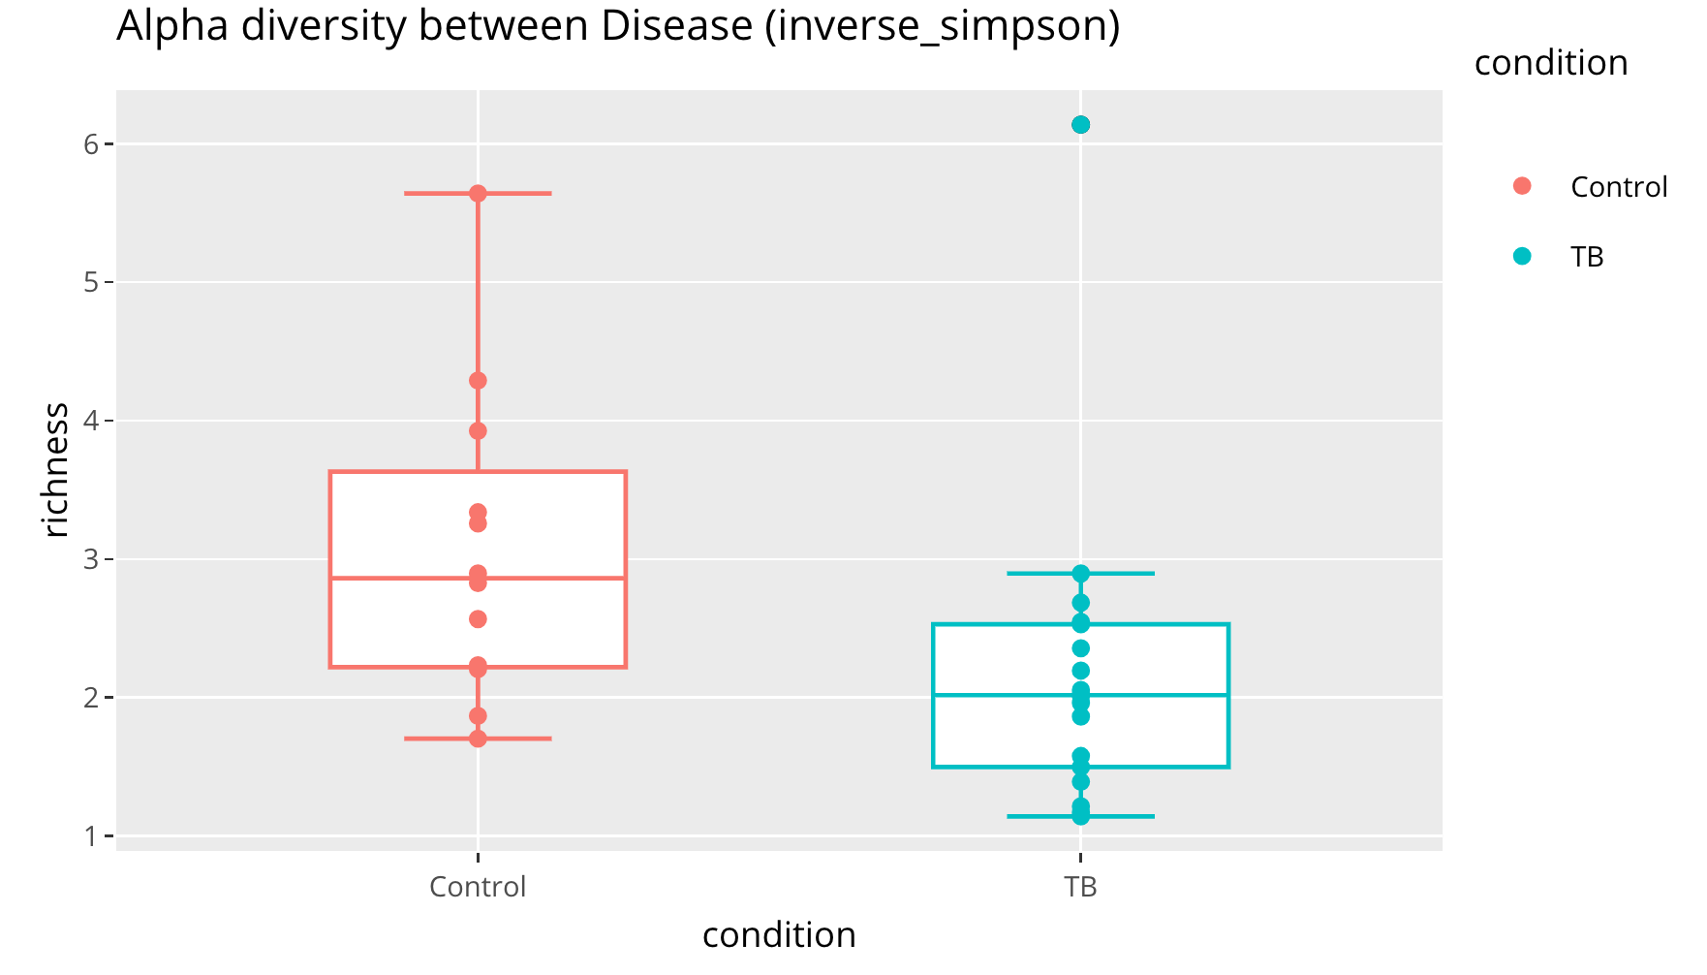
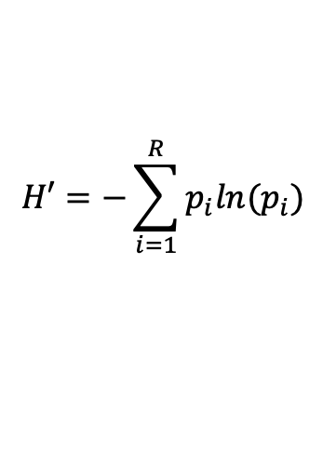
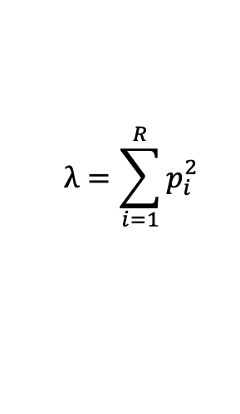
Alpha Diversity
Measures ‘richness’ of the microbiome
Number of species relative proportions
Simpson Index:
Shannon Index:
$$λ=\sum_{i=1}^{R}{p_{i}^{2}}$$
$$H′=−\sum_{i=1}^{R}{p_{i}ln{(p}_{i})}$$

Slide 41
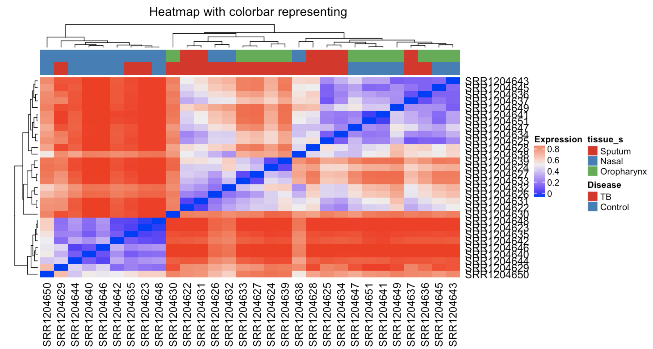
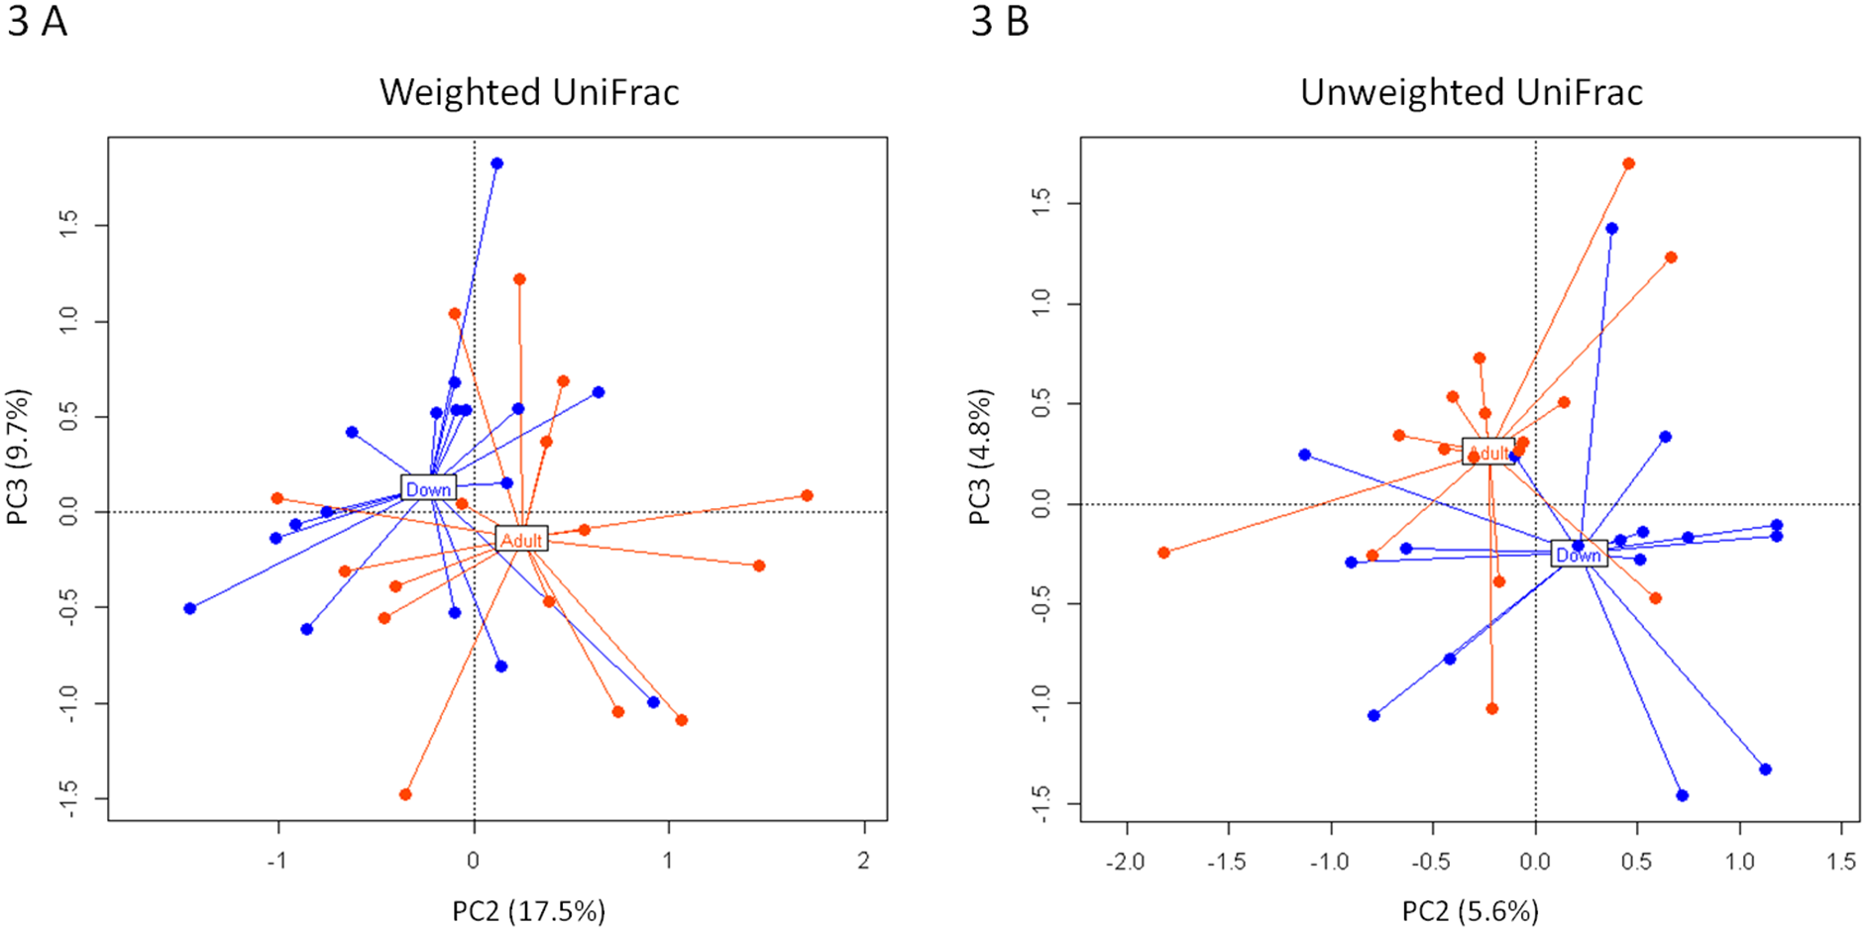
Beta Diversity
Measures similarity between two samples
Microbiome equivalent for ‘correlation’
Weighted Unifrac:
Biagi, et al., PLOS One 2014

Slide 42
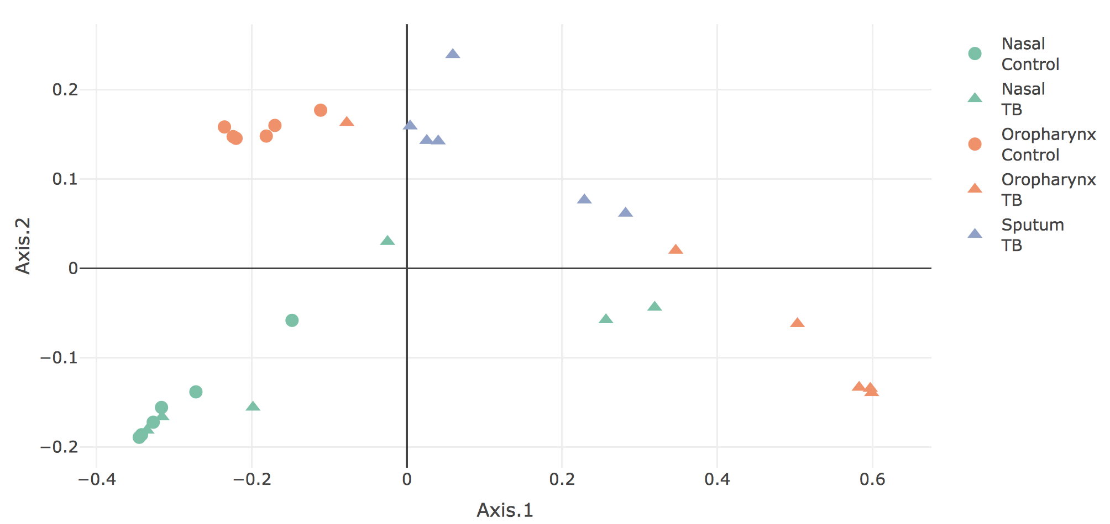
Principal Coordinate Analysis
Dimension reduction for metagenomic data
Example TB microbiome in multiple tissues:

Slide 43
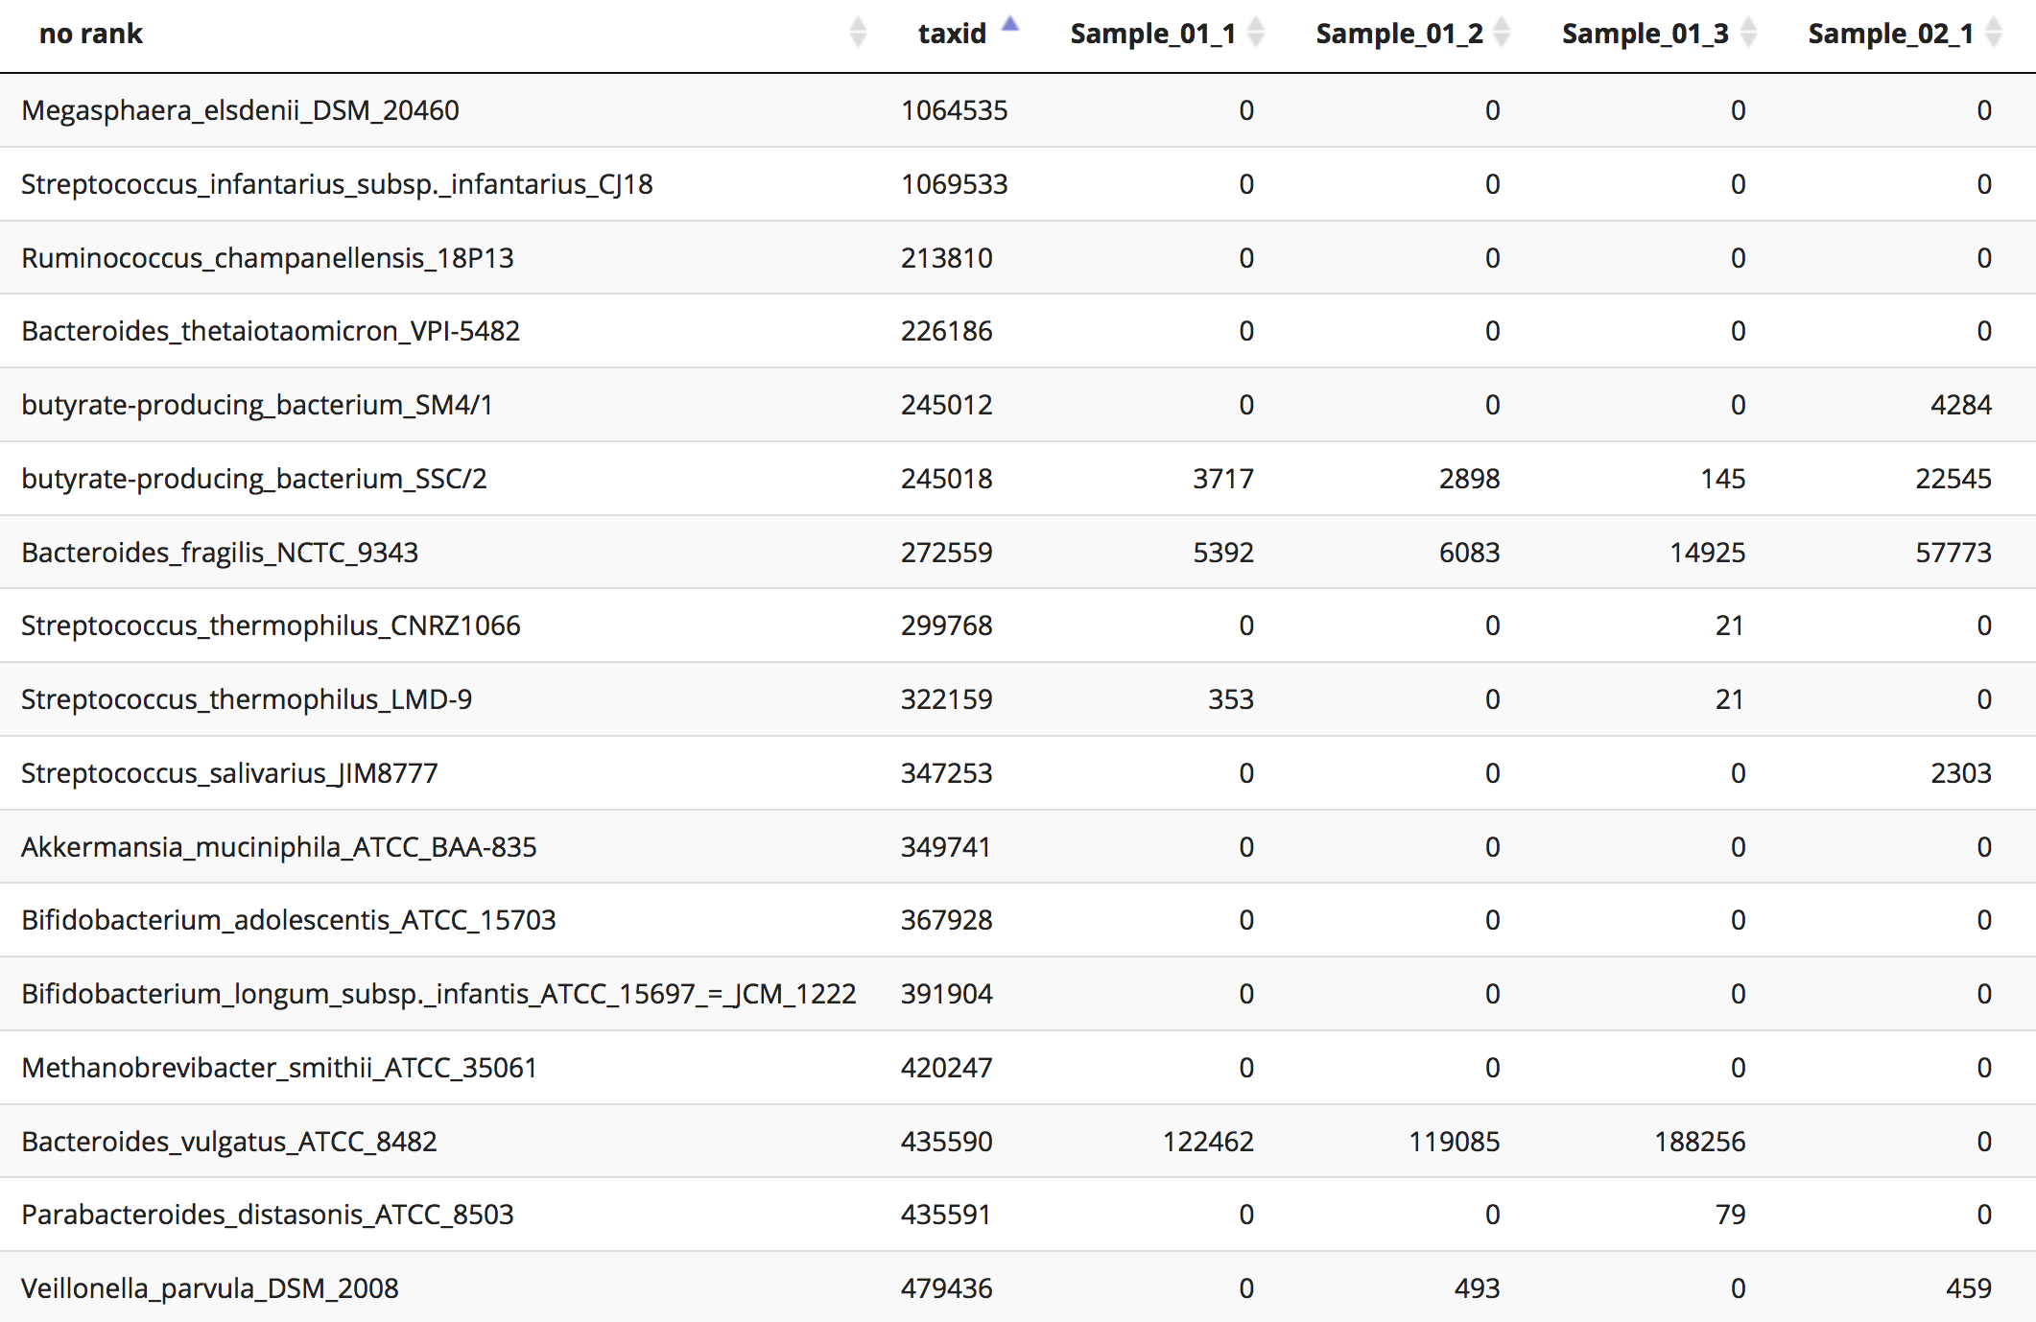
OTU Tables
Organization Taxonomic Units (OTUs)
Rows are microbes; columns are samples

Slide 44

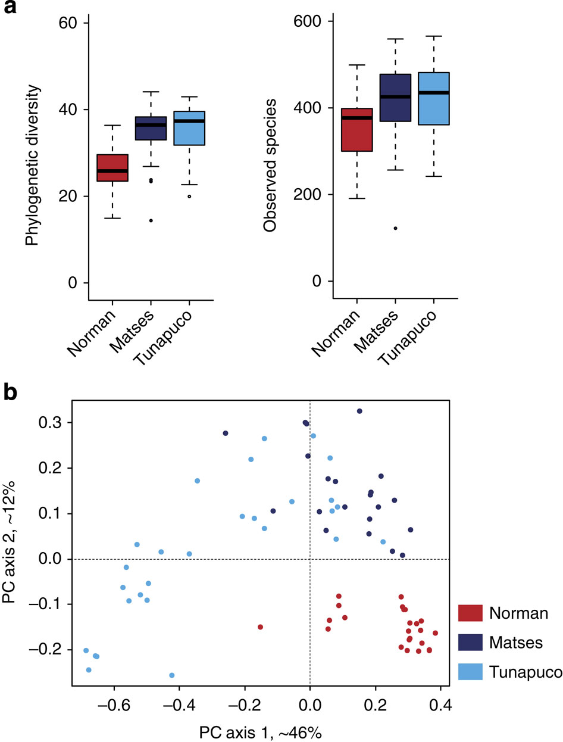
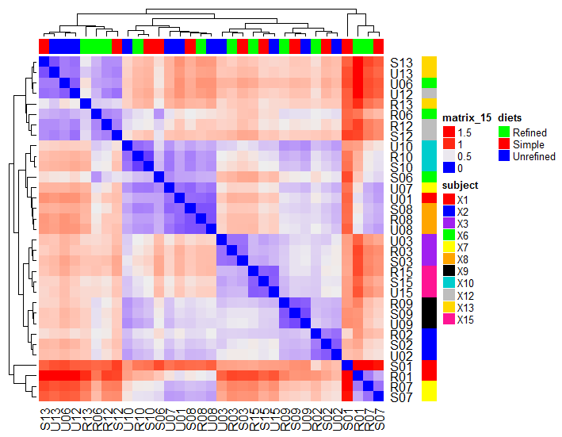

16S rDNA analysis
Qiime is a standard 16S analysis toolkit. It used PyNAST to align reads to a reference (probably greengenes) and can automatically spit out summary metrics and plots.
Alpha diversity
OTUs observed
Beta diversity
Taxa abundance

Slide 45



Accuracy in Mock Communities
Aubrey (Brie) Odom-Mabey
Tyler Faits
Odom, et al., Scientific Reports, 2023

Slide 46


Slide 47


Slide 48









Collect specimen
Host Response Pathways
DNA/RNA Sequencing
PI3K/Akt/mTOR signaling
Apoptosis/Cell Death
Genome Sequence Library
Microbiome Profiling
Host Profiling
Align to Microbial Genomes
(PathoScope; Hong et al., 2014)
Influenza
E. coli
Align to Human Genome
RSV
Pneumonia
Plague
Human
Anthrax
HIV
Influenza
Pneumonia
RSV
Integrate Results
(animalcules; Zhao et al. 2021)
Human
Sparse Baysian Factor Analysis
(ASSIGN; Shen et al. 2015)
Bayesian Mixture Modeling
(PahoID; Francis et al., 2013)
Pathway Activation
Microbial Abundance
(animalcules; Zhao et al. 2021)
Pathogen Abundance
Immune Pathway Activity
(Johnson et al., 2021)
Control Asthma
Castro-Nallar et al., 2015
48

Slide 49

PathoScope: `Plug and Play' Metagenomic Framework
PathoScope Core Modules:
PathoLib: Automatic genome library extraction and optimization
PathoMap: Align reads and filter reads from host, etc.
PathoID: Reassign ambiguous reads, identify strains present, and estimate proportions of RNA/DNA
PathoReport: Summary reports, XML report, contigs, annotations etc
PathoScope Optional Modules:
PathoQC: Parallel quality control wrapper for multiple QC programs.
PathoDB: Extract annotation from NCBI (name, genes, products,lineage, etc)
Changjin Hong
Hong et al., Microbiome, 2015
Solaiappan Manimaran

Slide 50


Keith Crandall
Owen Leete (Francis)

Slide 51


MetaScope (New!)
“PathoScope-like pipeline” fully integrated into R
Features and functions
download_refseq: Downloads genome libraries/indexes
align_target: aligns reads to multiple reference genomes using Bowtie2 or Rsubread, combines and orders results
filter_host: removes reads that align to host genomes
metascope_id: reassigns ambiguous read aligmments (Bayesian mixture modeling)
Rahul Varki
Aubrey (Brie) Odom-Mabey
https://github.com/compbiomed/MetaScope

Slide 52




Animalcules: Interactive Microbiome Analysis Toolkit
Yue (Jason) Zhao
(animalcules: Interactive Microbiome Analytics and Visualization in R, Zhao et al., Microbiome, 2021)
Anthony Federico

Slide 53


Asthma Nasal Metatranscriptomics
Nasal brushings, Total RNA-seq
Healthy’ asthmatic (n=8) and control children (n=6)
Eduardo
Castro-Nallar
Keith Crandall
Ying Shen
Castro-Nallar et al., BMC Medical Genomics, 2015

Slide 54


Aperiomics (metagenomics)
Metagenome sequencing to solve hard-to-diagnose infections
Pleural Effusion:
F. nucleatum

Slide 55
Aperiomics Case Study
68 year old woman from West Virginia
Unexplained pain much of her adult life
Diagnoses: chronic Lyme, arthritis, pain unknown origin
Blood test, metagenomic profiling
30M DNA seqs, 270 matched Mtb
Not Lyme, she had extrapulmonary TB!

Slide 56



History of microbes and cancer immunotherapy
2600 B.C.: Imhotep, Egyptian physician (and architect/ engineer) treated tumors with a poultice to induce infection designed to induce regression of tumors
13th century: St. Peregrine (“The Cancer Saint”) experienced spontaneous regression of tumor, after the tumor became infected
18th and 19th centuries: deliberate infection of tumors after surgery was common practice. Many physicians reported successful treatment of cancer with infection
1891: William Coley developed “Coley’s Toxins” comprised of a milieu of heat-killed bacteria

Slide 57

Inhibitors of PD-1/PD-L1 in cancers
Han, Y., Liu, D. & Li, L. PD-1/PD-L1 pathway: current researches in cancer. Am. J. Cancer Res. 10, 727–742 (2020)

Slide 58

Gut microbiome is associated antitumor immunity.
Gopalakrishnan, V. et al. Gut microbiome modulates response to anti-PD-1 immunotherapy in melanoma patients. Science 359, 97–103 (2018)

Slide 59

Study Design Summary
Time
0
…
Anti-PD-1 Therapy
💊
💊
16SrRNA Sequencing
😮
16SrRNA Sequencing
t
💊
💩
LC-MS
🩸
16SrRNA Sequencing
👃
😮
😮
👃
👃
💩
💩
🩸
🩸
Tumor Growth
📏
📏
📏
Align to Microbial Genomes
(PathoScope; Hong et al., 2014)
S. aureus
S. pneumoniae
E. coli
Bayesian Mixture Modeling
Microbial Abundance
(animalcules; Zhao et al. 2021)

Slide 60


Alpha Diversity, Shannon Index Over Time

Slide 61

Beta Diversity, PHATE Embedding

Slide 62


Buccal Samples, Significant OTUs, Baseline

Slide 63





Examining the maternal/infant health and HIV exposure in Zambia
Southern Africa Mother Infant Pertussis Study (SAMIPS)
A small Zambian cohort could provide insight into HIV exposure phenomenon in NP
Characterize NP microflora over 14 weeks
Left inset: Images of Chawama compound, a slum in Lusaka, Zambia where infants were enrolled.
Images by Britta Pedersen
Chris Gill
Notes:
Now, the motivation behind this work is to help contribute to the understanding of this HIV-exposure effect. The thinking is that a small-scale investigation could be possible with a cohort from the Southern Africa Mother-Infant pertussis study, known as SAMIPS.
This was a longitudinal birth cohort in Lusaka, Zambia that enrolled both HIV+ and HIV- mothers and their infants. Nasopharyngeal swabs were obtained every 2 weeks, from 1 to 14 weeks.
We aggregated nasopharyngeal swabs from 20 of these infant-mother pairs to analyze microbiome characteristics in HIV exposed versus unexposed infants over time. We hope to answer questions about the nature of the HIV exposure effect, such as whether immunological deficits exist between groups. Our efforts would add to limited research on HIV exposure effects in the nasopharynx.

Slide 64



Infant Respiratory Health and HIV Exposure in Zambia
Nasal swabs from infants at birth and at 2-week intervals for 12 weeks
Nasal swabs from mothers at (infant’s) birth and at 12 weeks
 | HIV- Mother | HIV+ Mother
Healthy infant (for at least 3 months)
Infant respiratory illness in first 3 months
Chris Gill
N=17
N=13
Aubrey (Brie)
Odom-Mabey
Rotem Lapidot
N=7
N=3
Jessica McClintock
Tyler Faits

Slide 65

Development of microbiota over time
Chris Gill
Rotem Lapidot
Tyler Faits

Slide 66

GEE background: Generalized linear models
Notes:
Next, we’re going to look at my modeling approach. First, I need to give a bit of background to generalized estimating equations by briefly reviewing some important properties of generalized linear models, or GLMs.
GLMs allow for the specification of different response variable distributions with a single unified method.
If we are trying to model a continuous variable like subject heights, we can model the response Y with a normal distribution.
If our response is something with only two outcomes, like wins or losses, then we can model the binary response with a Bernoulli distribution.
And if our response is discrete, like the number of times an event occurs in an interval, then we could model the response with a Poisson distribution.
Each of these regression types will alter the relationship between the responses and the linear combination of predictors, known as the linear predictor.

Slide 67

Generalized Estimating Equations (GEEs)
First-order Auto Regressive/AR(1) correlation structure:
Correlation among responses within clusters (infants) decays exponentially with time
Extends GLM to accommodate correlated Ys
Abundance of a taxon
Longitudinal
7 timepoints
AR(1) correlation structure
Link function
Identity link - normal distribution
No distribution/likelihood assumption
Wald hypothesis tests
Time 0
Time 1
Time 2
Time 3
Time 0
Time 1
Time 2
Time 3
Notes:
Generalized estimating equations are useful in our analysis, as they extend the concept of the GLM to accommodate correlated Y’s, which in our case is the abundance of a given taxon.
They can handle longitudinal data, using a first order autoregressive correlation structure to correlate responses within clusters whose correlations decay exponentially with time.
They also allow us to model our data with different distributions, although in this case we assume normality of the abundances and use the identity link. Since there’s no distribution or likelihood assumption, we can use Wald hypothesis tests to test the coefficients.

Slide 68



GEE Models for Microbiome Analysis
Over-dispersed, zero-inflated, high dimensional, compositional data
For example, model for Batch effects:
$Y_{ijg}\sim NB(μ_{ijg},φ_{ig})$
$$\log{μ_{ijg}}=α_{g}+X_{j}β_{g}+γ_{ig}+\log{N_{j}}$$
$$var\left(Y_{ijg}\right)=V_{ij}^{1/2}R_{m}V_{ij}^{1/2}$$
$$V_{ij}={diag}_{m}\left(μ_{ijm}+φ_{im}μ_{ijm}^{2}\right)$$
R_{m} describes compositional nature
Methods and tools for longitudinal microbiome data
Yuqing Zhang
Brie Odom-Mabey
Howard Fan
Lucas Schiffer

Slide 69


Slide 70



Slide 71



Microbiome Biomarker for Cancer Interception
Streptococci
Cancer
Ethel Nankya
Control
Yue (Jason) Zhao

Slide 72





Microbial Interactions in Cancer
Streptococcus
?
Corynebacterium
Daniel Segre

Slide 73

Microbial Interactions in Cancer
Streptococcus
?
Corynebacterium
Daniel Segre
Microbial Interaction Network Database (MIND)
Gut
Skin
Correlation
Anticorrelation

Slide 74


Host-Microbe Interactions in Cancer
PI3K_AKT_MTOR Signaling:
Early event lung cancer development (Gustafson, STM, 2010)
Associated with Streptococcus in lung (Tsay, AJRCCM, 2018)
Reversible by chemoprevention using myo-inositol (microbial metabolite)
Other potential microbe/host interactions:
Corynebacterium: PI3K, glycolysis, and reactive oxygen species
Pseudomonas: IL6, interferon response
Massilia: MYC and EMT signaling
Catellicoccus: Oxidative phosphorylation

Slide 75





Slide 76





Slide 77

Thank you!

